Slide 1
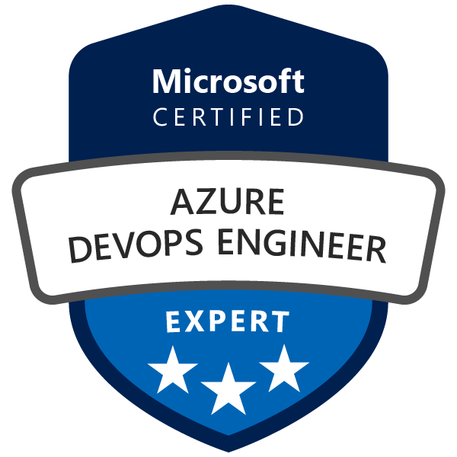
Exam AZ-400: Microsoft Azure DevOps Solutions Crash Course
Tim Warner @TechTrainerTim

Slide 2

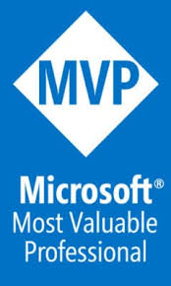
Tim Warner
Based in Nashville, TN, US
MCT, MVP
Twitter: @TechTrainerTim
Badge: timw.info/doc

Slide 3
Session 2 of 2 Learning Goals
Session 1 big picture review
Azure DevOps identity and security
Infrastructure and configuration management
Continuous monitoring
Dependency management
System feedback mechanisms
AZ-400 exam strategy, revisited

Slide 4
Course Materials
timw.info/az400

Slide 5
The Story So Far...

Slide 6
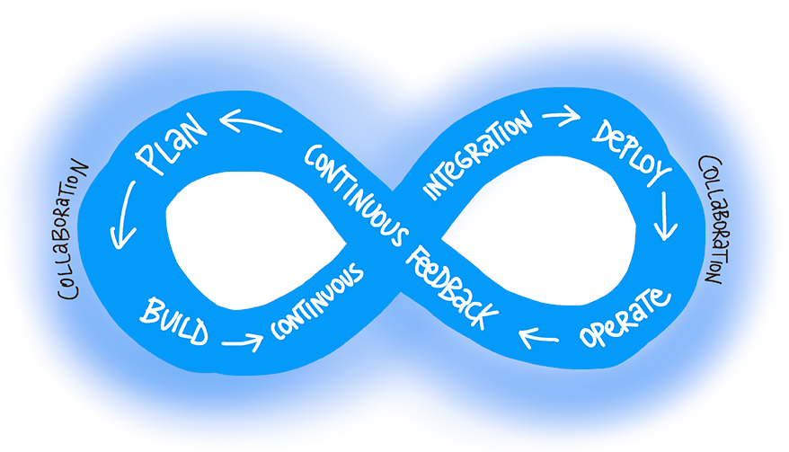
DevOps
"The union of people, process, and products to enable continuous delivery of value to our end users"
timw.info/dodef

Slide 7
CI / CD
Continuous integration: Merging code changes to main branch often
Continuous delivery: Ability to deploy your application to your customers with a button click
Continuous deployment: Automated code movement, potentially to production

Slide 8
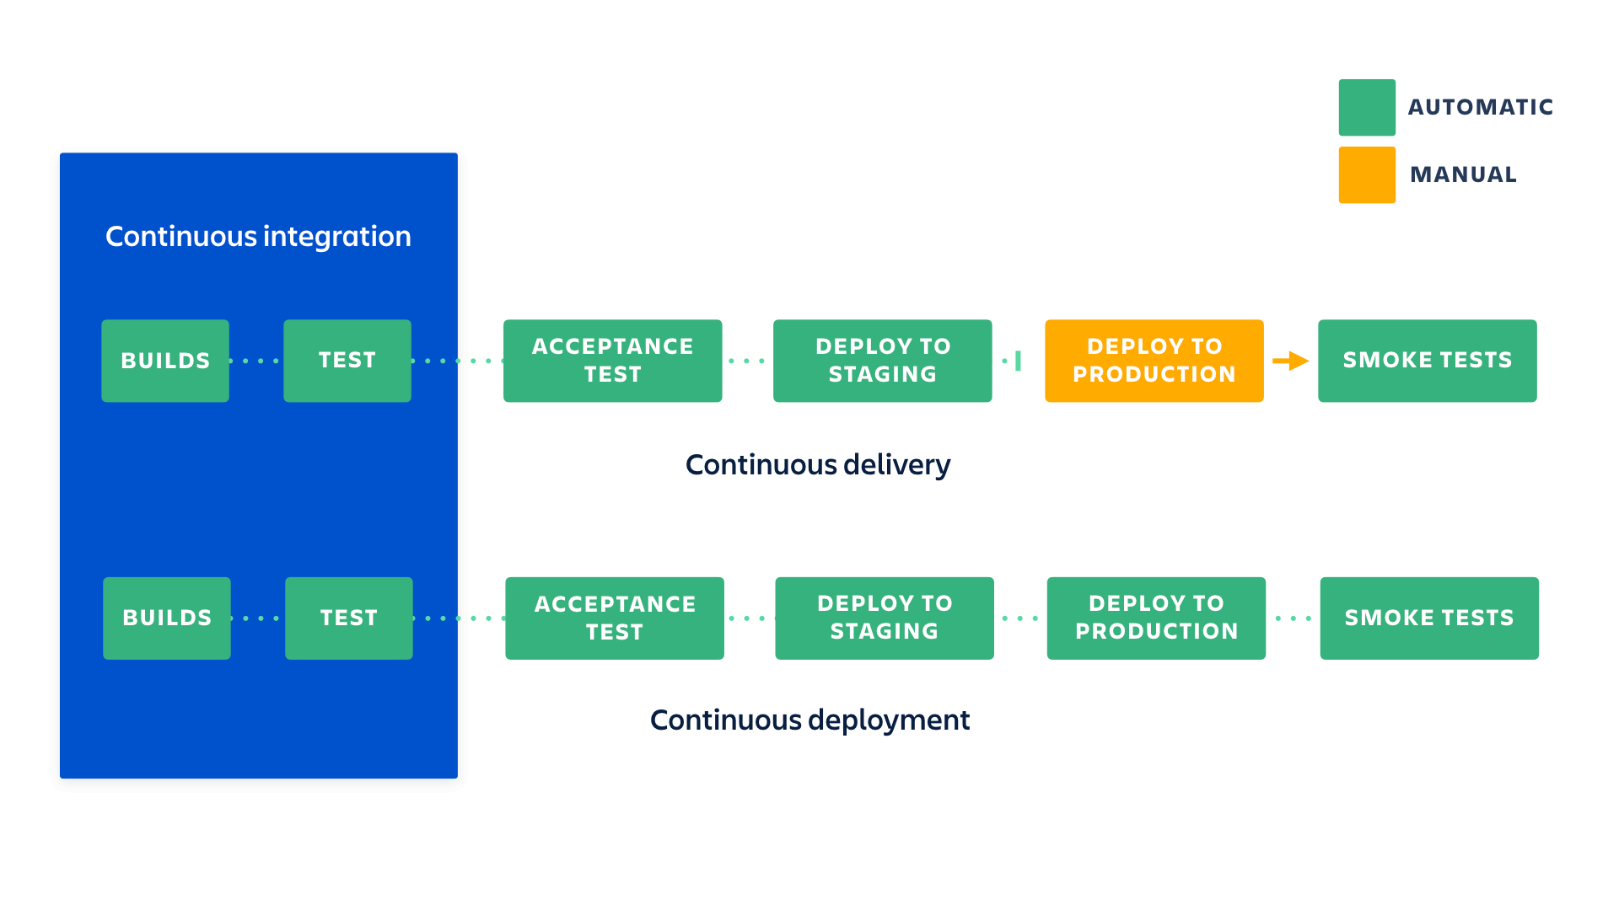
CI / CD
Triggered by commit/pull request
Triggered by successful build
"Shift left"
Gates/approvals
timw.info/atl

Slide 9
Data Formats/Languages to Learn
JSON
YAML
(Azure) PowerShell
Azure CLI
KQL

Slide 10
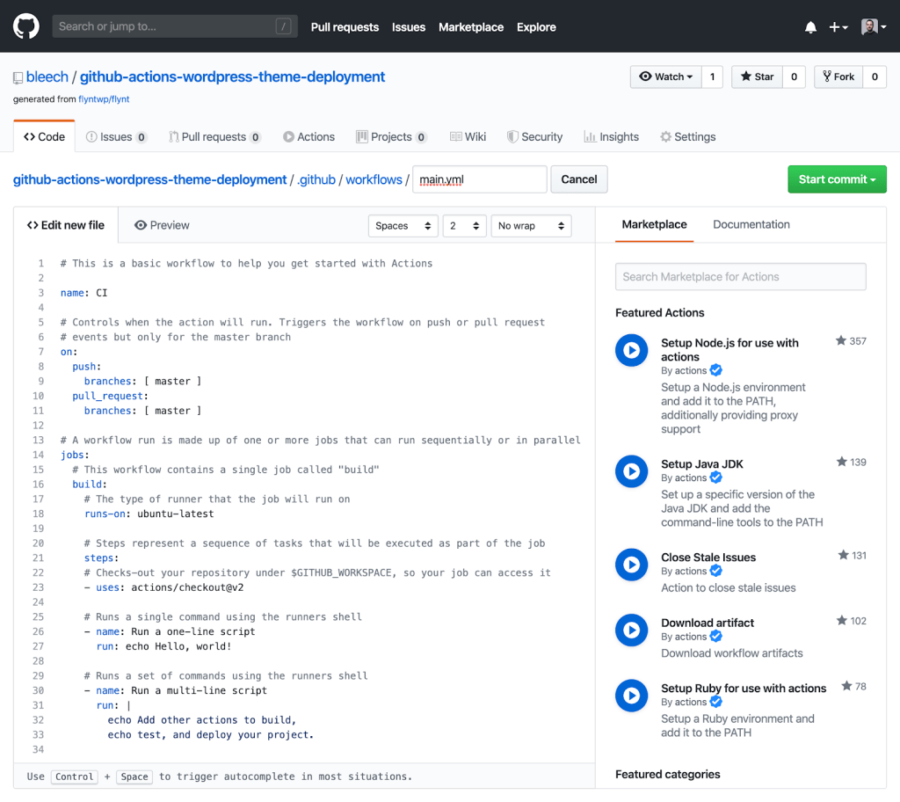
GitHub Actions
CI/CD workflow engine
Triggered by commit/pull request
GitHub-hosted build agents
Docker containers
Self-hosted agents
YAML workflow (pipeline) definition
Third-party tasks

Slide 11
Infrastructure as Code as Containers

Slide 12
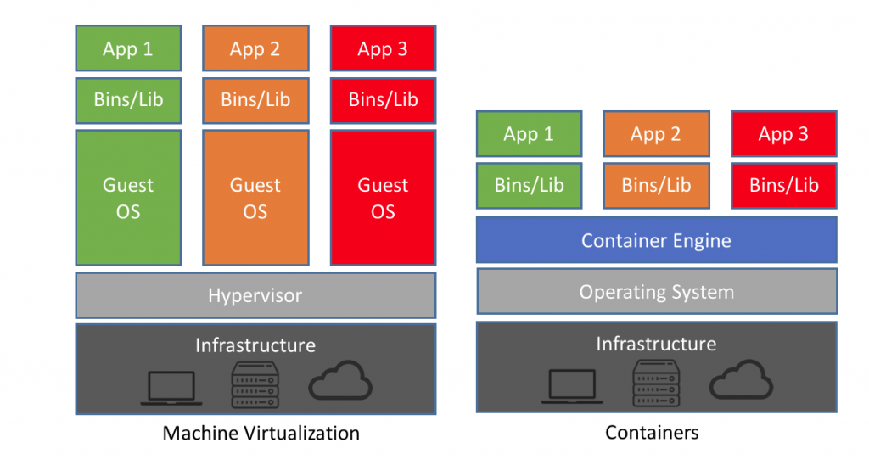
Containers vs. VMs
timw.info/nac
Notes:
Could mention that Imperative can also be known or called as procedural. And Declarative can sometimes be referred to as functional.
Declarative abstracts away the methodology of how a state is achieved.
A declarative approach would generally be the preferred option where ease of use is the main goal. Azure Resource Manager template files are an example of a declarative automation approach.
An imperative approach may have some advantages where there are complex scenarios where changes in the environment take place relatively frequently, which need to be accounted for in your code.
There is no absolute on which is the best approach to take, and individual tools may be able to be used in either declarative or imperative forms. The best approach for you to take will depend on your particular needs

Slide 13
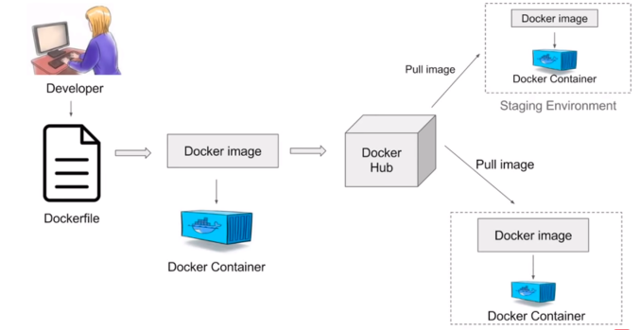
Docker Container Build and Deployment Workflow
timw.info/dcw2
Notes:
Could mention that Imperative can also be known or called as procedural. And Declarative can sometimes be referred to as functional.
Declarative abstracts away the methodology of how a state is achieved.
A declarative approach would generally be the preferred option where ease of use is the main goal. Azure Resource Manager template files are an example of a declarative automation approach.
An imperative approach may have some advantages where there are complex scenarios where changes in the environment take place relatively frequently, which need to be accounted for in your code.
There is no absolute on which is the best approach to take, and individual tools may be able to be used in either declarative or imperative forms. The best approach for you to take will depend on your particular needs

Slide 14
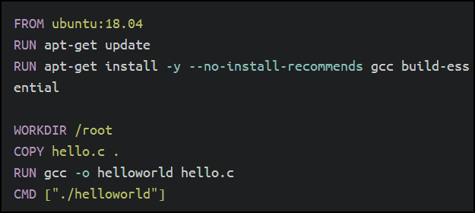
Single-Stage Image Builds
Multiple dockerfiles/images for different environments
Larger storage footprint/attack surface
More management
timw.info/msdb
Notes:
Could mention that Imperative can also be known or called as procedural. And Declarative can sometimes be referred to as functional.
Declarative abstracts away the methodology of how a state is achieved.
A declarative approach would generally be the preferred option where ease of use is the main goal. Azure Resource Manager template files are an example of a declarative automation approach.
An imperative approach may have some advantages where there are complex scenarios where changes in the environment take place relatively frequently, which need to be accounted for in your code.
There is no absolute on which is the best approach to take, and individual tools may be able to be used in either declarative or imperative forms. The best approach for you to take will depend on your particular needs

Slide 15
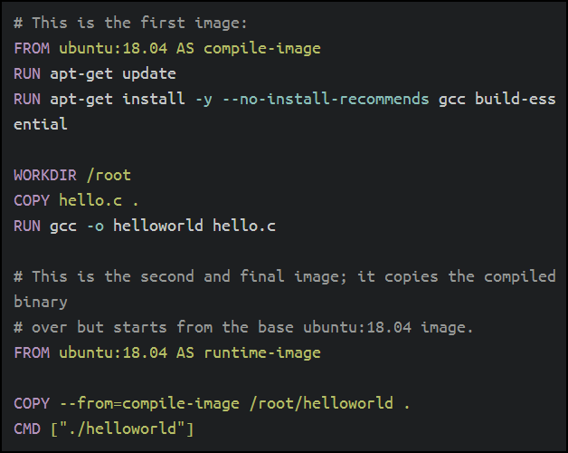
Multi-Stage Image Builds
Similar pattern to multi-stage YAML pipeline
Copy elements from one image to another
Slimmer/more secure images
timw.info/msdb
Notes:
Could mention that Imperative can also be known or called as procedural. And Declarative can sometimes be referred to as functional.
Declarative abstracts away the methodology of how a state is achieved.
A declarative approach would generally be the preferred option where ease of use is the main goal. Azure Resource Manager template files are an example of a declarative automation approach.
An imperative approach may have some advantages where there are complex scenarios where changes in the environment take place relatively frequently, which need to be accounted for in your code.
There is no absolute on which is the best approach to take, and individual tools may be able to be used in either declarative or imperative forms. The best approach for you to take will depend on your particular needs

Slide 16
Azure Support for Containers
Azure Container Registry
Azure Container Instance
Azure Kubernetes Service (AKS)
timw.info/sadf
Notes:
Could mention that Imperative can also be known or called as procedural. And Declarative can sometimes be referred to as functional.
Declarative abstracts away the methodology of how a state is achieved.
A declarative approach would generally be the preferred option where ease of use is the main goal. Azure Resource Manager template files are an example of a declarative automation approach.
An imperative approach may have some advantages where there are complex scenarios where changes in the environment take place relatively frequently, which need to be accounted for in your code.
There is no absolute on which is the best approach to take, and individual tools may be able to be used in either declarative or imperative forms. The best approach for you to take will depend on your particular needs

Slide 17
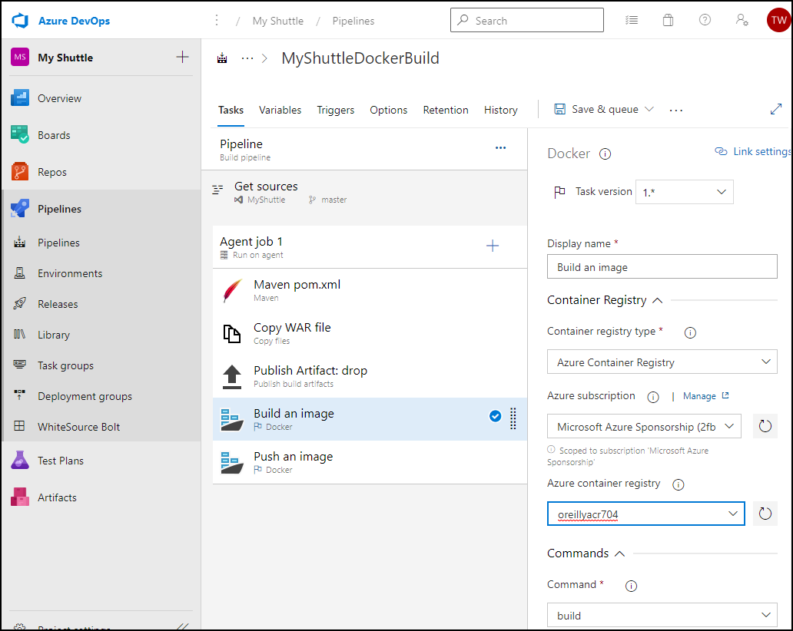
Azure DevOps Docker Build/Release Tasks
Notes:
Could mention that Imperative can also be known or called as procedural. And Declarative can sometimes be referred to as functional.
Declarative abstracts away the methodology of how a state is achieved.
A declarative approach would generally be the preferred option where ease of use is the main goal. Azure Resource Manager template files are an example of a declarative automation approach.
An imperative approach may have some advantages where there are complex scenarios where changes in the environment take place relatively frequently, which need to be accounted for in your code.
There is no absolute on which is the best approach to take, and individual tools may be able to be used in either declarative or imperative forms. The best approach for you to take will depend on your particular needs

Slide 18
Infrastructure as Code and Configuration Management

Slide 19
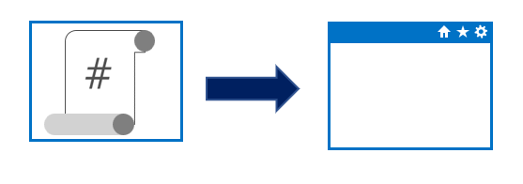
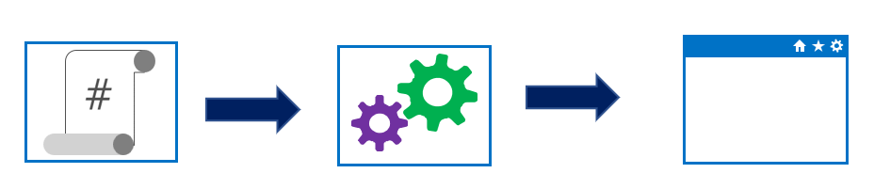
Imperative vs. Declarative
Approaches to implementing infrastructure and configuration as code
Declarative
Functional
Defines what the final state should be
Imperative
Procedural
Defines the “how” for what the final state should be
Notes:
Could mention that Imperative can also be known or called as procedural. And Declarative can sometimes be referred to as functional.
Declarative abstracts away the methodology of how a state is achieved.
A declarative approach would generally be the preferred option where ease of use is the main goal. Azure Resource Manager template files are an example of a declarative automation approach.
An imperative approach may have some advantages where there are complex scenarios where changes in the environment take place relatively frequently, which need to be accounted for in your code.
There is no absolute on which is the best approach to take, and individual tools may be able to be used in either declarative or imperative forms. The best approach for you to take will depend on your particular needs

Slide 20
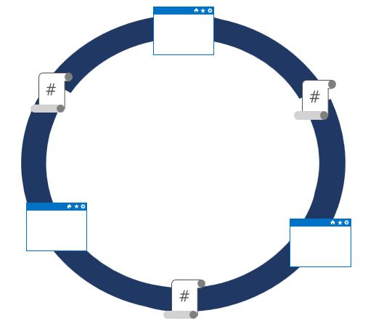
Idempotence
Idempotence – definition
Mathematical term used in the context of infrastructure and configuration as code
Ability to apply one or more operations against a resource, resulting in the same outcome
To attain idempotence
Automatically configure and reconfigure an existing set of resources, or
Discard existing resources and spin up a fresh environment
Notes:
Idempotence – mathematical term used in the context of infrastructure and configuration as code, referring to the ability to apply one or more operations against a resource, resulting in the same outcome.
For more information about idempotence in general and in the context of Azure, see - https://www.wintellect.com/idempotency-for-windows-azure-message-queues/

Slide 21
Configuration Drift
Configuration drift
Process whereby a set of resources change their state over time
Can occur from changes made by people, processes, or programs
Potential security risks introduced by configuration drift
Open ports that should have been closed
Inconsistent patching across environments
Software that doesn’t meet compliance requirements
Solutions that can help
Windows PowerShell Desired State Configuration
Azure Policy
Many non-Microsoft solutions integrated with Azure

Slide 22



What is Azure Resource Manager?
Azure Resource Manager is a management layer in which a resource group and all the resources within it are created, configured, managed, and deleted
Azure Resource Manager: Management Layer
Azure PowerShell
Azure CLI
Azure Portal
REST APIs
Client SDKs
Notes:
Azure Resource Manager provides a consistent management layer that allows you automate deployment and configuration of resources, using different automation and scripting tools such as Microsoft Azure PowerShell, Azure Command-Line Interface (Azure CLI), Microsoft Azure portal, REST API, and client SDKs.

Slide 23
Why Use ARM templates?
Make deployments faster and more repeatable
Improve consistency by providing a common language
Enable you to deploy multiple resources in the correct order by mapping out resource dependencies
Reduce manual, error-prone tasks
Templates can be linked together to provide a modular solution
Notes:
Can discuss some of the benefits of using ARM templates when deploying and configuring resources in Azure.

Slide 24
What is Azure CLI?
Command-line program to connect to Azure
Execute administrative commands on Azure resources through a terminal, command-line prompt, or script, instead of a web browser
For example, to restart a VM use the command:
az vm restart -g MyResourceGroup -n MyVm
Can be installed on Linux, Mac, or Windows computers
Can be use interactively or scripted
Interactive: Issue commands directly at the shell prompt
Scripted: Assemble the CLI commands into a shell script and then execute the script
Notes:
The Azure CLI is a command-line program to connect to Azure and execute administrative commands on Azure resources. It runs on Linux, macOS, and Windows and allows administrators and developers to execute their commands through a terminal or command-line prompt (or script!) instead of a web browser.
Mention the cross-platform command-line tools support for managing Azure resources, as well as the ability to access the CLI from the Cloud Shell.

Slide 25
What is Azure PowerShell?
Module added to Windows PowerShell or PowerShell Core
Connect to your Azure subscription and manage resources
Adds the Azure-specific commands
Example: the NewAzVm command
New-AzVm ‘
-ResourceGroupName “CrmTesting ResourceGroup” ‘
-Name “CRMUnitTests” ‘
-Image “UbuntuLTS”
Azure PowerShell available either locally or via the Cloud Shell
Can be use in interactive or scripting mode

Slide 26
VM Extensions with PowerShell
Include Azure VM extensions with ARM templates for making configuration changes on already deployed VMs
To see a list of individual extensions:
Get-Command Set-*Extension* -Module Az.Compute
Example of a Custom Script Extension
Set-AzureRmVMCustomScriptExtension ` -ResourceGroupName "ResourceGroup11" ` -Location “Central US" -VMName "VirtualMachine07“` -Name "ContosoTest" –TypeHandlerVersion "1.1" ` -StorageAccountName "Contoso" `
-StorageAccountKey <StorageKey> `
-FileName "ContosoScript.exe"
-ContainerName "Scripts"
Notes:
Point out that the wild characters in the command are intentional and its use will return all cmdlets that contain the word “extension”, so they can all be viewed.
Also, point students to the Azure documentation from where the sample Custom Script Extension is taken.
Set-AzureRmVMCustomScriptExtension
https://docs.microsoft.com/en-us/powershell/module/azurerm.compute/set-azurermvmcustomscriptextension?view=azurermps-6.13.0#examples

Slide 27
Azure Cloud Shell
Cloud Shell hosted in the cloud and accessible via web browser and multiple access points including:
https://shell.azure.com
Directly via the Azure Portal,
Azure mobile app,
Visual Studio Code - Azure Account extension,
Authenticates automatically and securely with Azure
Can choose between Bash or PowerShell shell
Contains integrated script editor
Requires the creation of a storage account
Notes:
✔️ You might recommend the following video to students for viewing after class. It provides more details about Azure Cloud Shell. See Azure Friday – PowerShell in Azure Cloud Shell GA (https://azure.microsoft.com/en-us/resources/videos/azure-friday-powershell-in-azure-cloud-shell-ga/).

Slide 28
Azure Automation

Slide 29

What is Azure Automation?
An Automation service integrated with Microsoft Azure for automating the creation, deployment, monitoring and maintenance of Azure resources and resources external to Azure
Integration with Microsoft Azure remove some complexity of automating in Azure
Azure Automation Capabilities include:
Manage Shared resources
State configuration
Integration with GitHub, Azure DevOps Git/TFVC
Update management
Can automate Windows or Linux environments
Can apply to any system that exposes an API over internet protocols

Slide 30
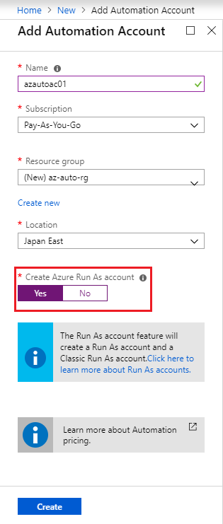
Automation accounts
To use Azure Automation you must create an Azure Automation account
Automation account acts as a container in which you store, manage and use automation artifacts
Provides a way to separate your environments or further organize your Automation workflows and resources.
Requires subscription-owner level access as provides access to all Azure resources via an API
Need at least 1 but should have multiple for access control
Run As account
Can create when creating Azure Automation account
Creates a service principal user in Azure AD which allows access to Azure resources when running automation
Notes:
Could create Azure Automation accounts for dev, test, production, security, or other elements in your pipeline for more granular auditing, cost analysis and general management, as well as increased security.
When you create a Run As account, it creates a new service principal user in Azure Active Directory and assigns the Contributor role to this user at the subscription level

Slide 31
Infrastructure as a Service

Slide 32
Azure Virtual Machines
Azure VMs provide the benefits of virtualization, but must still be deployed, configured, and maintained
Operating system support for Windows and Linux OS deployments
Windows
Windows Server and Windows client images available in Azure Marketplace for development test and production
Images identified by publisher, offer, SKU, and version
Only 64-bit operating systems supported
Linux
Endorsed distributions available in Azure Marketplace
Additional Linux partner-products, such as Docker, Jenkins
Notes:
Mention how to find what Windows Server SKUs are available in different locations, using the Azure CLI example in the content, in this case West Europe. A similar query is shown for Linus RedHat SKUs in the West US region.
Call out the list of Linux endorsed distribution, and though not an extensive list you can point them to https://docs.microsoft.com/en-us/azure/virtual-machines/linux/endorsed-distros for a complete list of endorsed distributions with links to specific products.

Slide 33
Scaling Azure VMs
Use virtual machine scale sets (vmss) for managing a group of identical, load balanced VMs
Benefits of scale sets
Create and manage multiple VMs at large scale
Provide high availability and application resiliency
Automatically scale as resource demand fluctuates
Options to configure VMs deployed in a scale set
Use extensions to configure a VM post deployment
Deploy a managed disk with a custom disk image
Differences between VMs and scale sets
Scale sets provide automated versus manual creation, configuration, and integration for different scenarios
Notes:
Discuss some of the benefits of virtual machine scale sets for each of the scenarios in the table. When you have multiple VMs that must be deployed across Availability Zones or Availability Sets, or you need to control traffic where load balancer and gateway configuration is required, creating scale sets will be a significant benefit. In these scenarios, would you rather manually create and manage individual VMs, or automatically do this from a central configuration? Especially when you need to add more instances and ensure high availability.
Also, with scale sets, you can automatically scale out based on host metrics or things like Application Insights.
As with all quoted numbers related to service limits, quotas, and constraints, these can change over time.

Slide 34
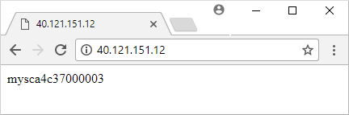
Walkthrough-Create Virtual Machine Scale Set
Create a resource group and a virtual machine scale set.
Deploy a sample web application using a Custom Script Extension.
Create a load balancer rule to allow traffic to reach the sample application.
Access the sample web application and obtain the load balancer’s IP address:
Load balancer distributes traffic to one of your VM instances
Notes:
✔ You could have students do this walkthrough, but it may be easier to just demonstrate the procedure. That way if some students don’t already have a subscription, you avoid the issues associated with ensuring all students can meet the prerequisites to do the task.
The slide lists the individual steps only for the walkthrough, so you will need to cover the sample script in the content.
Mention the “good hygiene” of removing resources when no longer needed, using az group delete.

Slide 35
Windows Server and Hyper-V containers
Windows Server containers
Additional services in the OS for managing containers – the Docker engine and compute services
Each container uses same set of system processes, with a set of application process to distinguish each container
Hyper-V containers
Specifically optimized to run containers
More secure alternative to Windows Server containers in the event of a vulnerability in the OS from sharing kernel and memory
Nano Server
Headless deployment option for running cloud applications
Runs as a container in a container host such as Server Core
Notes:
Use the diagrams to highlight the differences in architecture between Windows Server and Hyper-V containers. While there are similarities, focus on Hyper-V’s containers’ more optimized, virtualized environment that allows a more secure container implementation.
Note that Hyper-V containers are supported now on both Windows Server 2016 and newer versions, and on the Windows 10 Anniversary edition.
Note the different scenario examples listed for Nano Server.

Slide 36

Azure DevTest Labs
Creates environments consisting of pre-configured bases or Azure Resource Manager templates
Enables developers on teams to efficiently self-manage virtual machines (VMs) and PaaS resources without waiting for approvals.
Quickly provision Windows and Linux environments by using reusable templates and artifacts
Usage Scenarios:
Dev or Test environments
Integrate with CI/CD pipeline for automated tests and deleting images afterwards
Scale up your load testing by provisioning multiple test agents and create pre-provisioned environments for training and demos

Slide 37

Azure App Service
Fully managed environment enabling high productivity development
Platform-as-a-service (PaaS) offering for building and deploying highly available and scalable cloud apps for web and mobile
Developer productivity using .NET, .NET Core, Java, Python and a host of others
Pay only for the compute resources used
Azure platform handles infrastructure so that developers focus on core web apps and services
Azure provides enterprise-grade security and compliance. Azure Active Directory
Notes:
✔ With App Service, you pay for the Azure compute resources you use. The compute resources you use is determined by the App Service plan that you run your Web Apps on.
For more information, you can see:
App Service - https://azure.microsoft.com/en-us/services/app-service/
While the slide provides a high-level look at App Service, focus on some of the DevOps capabilities, such as continuous deployment from Azure DevOps, GitHub, Docker Hub, and other sources.
Additionally, security and compliance is built-in with App Service being ISO, SOC, and PCI compliant. Authentication occurs through Azure AD, or through the appropriate API for the various social media services.

Slide 38
App Service Plans
Define a set of compute resources for a web app to run
One or more apps can be configured to run in the same App Service plan
App Service plans define:
Region where compute resources will be created (West US, East US, etc.)
Number of virtual machine instances (scale count.)
Instance size (Small, Medium, Large)
Pricing tier (next slide)
Notes:
Don’t spend too much time on this and the next slide (which goes into a little more detail on the different pricing tiers). Just introduce the concepts of an app service plan.
For more information, you can see:
Azure App Service plan overview - https://docs.microsoft.com/en-us/azure/app-service/azure-web-sites-web-hosting-plans-in-depth-overview

Slide 39
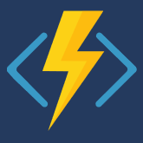
Azure Functions
Key features of Azure Functions
Choice of language
Pay-per-use pricing model
Support for NuGet and Node Package Manager
Integrated security with OAuth providers, such as Azure AD, Facebook, Microsoft Account, and others
Simplified integration with other Azure services and SaaS offerings
Options for code development and deployment (portal, continuous integration, GitHub, Azure DevOps Services, and more)
Functions runtime is open-source and available on GitHub
Notes:
Briefly cover the key Azure Function features as you’ve already covered the key attributes when discussing serverless computing… things like focus on code only and not underlying infrastructure, event driven, automatic scaling, charges billed only as used, and statelessness. Mention that Azure Functions are ideal when messages are being received for example, from an IoT solution, and can rapidly respond to the message/trigger.
The list of key features is not exhaustive, and you can see more information at https://docs.microsoft.com/en-us/azure/azure-functions/.
Mention that language support is dependent on the different versions of Azure Functions runtime, so be sure to check the documentation for the latest information – https://docs.microsoft.com/en-us/azure/azure-functions/supported-languages#languages-in-runtime-1x-and-2x
You can also point students to the Azure Serverless Computing Cookbook at https://azure.microsoft.com/en-us/resources/azure-serverless-computing-cookbook/, which is a downloadable guide to building serverless apps that is provided by Microsoft.

Slide 40
Batch services
Azure Batch – fully managed cloud service for job scheduling and compute resource management
Creates, manages, and scales a pool of compute nodes (VMs) to run largest, resource-intensive workloads.
Provides a job scheduler to submit jobs into the VM pool (or set of VM pools)
Requirements to run applications
Application (doesn’t need to be cloud aware)
Pool of VMs (Batch service creates, manages, and monitors the pool)
Job scheduler to define the tasks that make up the job
Location to store output, typically Blob storage
Notes:
Azure Batch is ideal for running batch processing automated tasks that are composed of large-scale jobs. This can be done on demand so is an excellent option when you need to run large scale batch processing in the cloud, without having to worry about predefining a schedule.
Essentially, it enables the breaking down of computationally intensive workloads into individual tasks and you get the benefits of efficiently running those tasks in parallel at scale.

Slide 41
Security and Compliance in the Pipeline

Slide 42
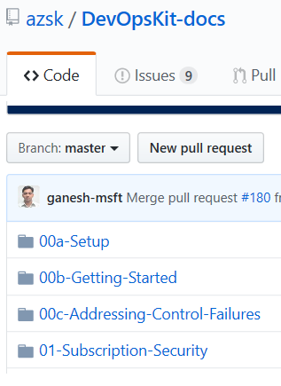
Secure DevOps Kit for Azure (AzSK)
AzSK is a collection of scripts, tools, extensions, automations
Helps secure the subscription
Enables secure development
Integrates security into CI/CD
Provides continuous assurance
Assists with alerts & monitoring
Governing cloud risks
Available at:
https://github.com/azsk/DevOpsKit-docs
Notes:
Consider going to the github site, https://github.com/azsk/DevOpsKit-docs, and showing the readme to call out some elements of the AzSK

Slide 43

Azure Security Center
Provide security recommendations
Monitor security settings
Monitor all your services
Use Azure Machine Learning
Analyze and identify potential attacks
Provide just-in-time (JIT) access control
Supports Windows and Linux operating systems
Available in two pricing tiers

Slide 44

Azure Policy
Is a service in Azure that you use to create, assign, and, manage policies
Provides enforcement by using policies and initiatives
Runs evaluations on your resources and scans for those not compliant
Comes with several built-in policy and initiative definitions
Integrates with Azure DevOps by applying any continuous integration (CI) and continuous deployment (CD) pipeline policies
✔️ An example of an Azure policy that you can integrate with your DevOps pipeline is the Check Gate task
Notes:
Azure Policy Check Gate - https://docs.microsoft.com/en-us/azure/devops/pipelines/tasks/deploy/azure-policy-check-gate?view=vsts

Slide 45

Azure Key Vault
Usage scenarios
Secrets management
Key management
Certificate management
Hardware security modules
Benefits
Centralized application secrets
Securely stored secrets and keys
Monitor access and use
Simplified administration of application secrets
Integrate with other Azure services
Centralized cloud service for storing your applications' secrets

Slide 46
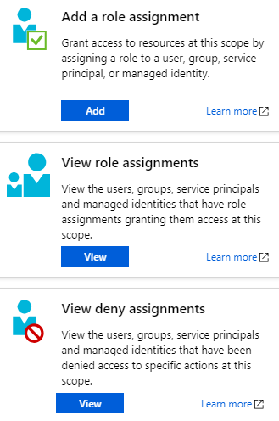
Role-Based Access Control (RBAC)
Segregate duties within your team and grant only the amount of access to users that they need to perform their jobs
Fine-grained access management for Azure resources
Grant users the lowest privilege level that they need to do their work
No additional cost to all Azure subscribers
Built-in roles for an allow model
Notes:
Examples of when you might use RBAC include when you want to:
Allow one user to manage VMs in a subscription, and another user to manage virtual networks.
Allow a database administrator (DBA) group to manage SQL Server databases in a subscription.
Allow a user to manage all resources in a resource group, such as VMs, websites, and subnets.
Allow an application to access all resources in a resource group.

Slide 47
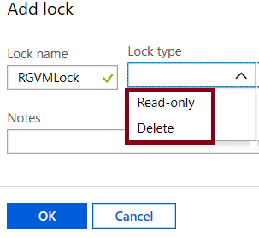
Locks
Prevent accidental deletion or modification of your Azure resources
CanNotDelete - means authorized users can still read and modify a resource, but they can't delete the resource
ReadOnly - means authorized users can read a resource, but they can't delete or update it. Applying this lock is like restricting all authorized users to the permissions granted by the Reader role
In the Azure portal, the locks are called Delete and Read-only respectively

Slide 48

Azure Blueprints
Allows for the definition of a repeatable set of Azure resources that implement and adhere to an organization's standards, patterns, and requirements
Can ensure a deployment meets an organization's standards, patterns, and requirements.
Is a declarative way to orchestrate deployment for various resource templates and other artifacts
Provides for traceability and auditing as well as adherence
1
2
3
Create an Azure blueprint
Assign the blueprint
Track the blueprint assignments
The blueprint definition (what should be deployed) and the blueprint assignment (what is deployed) supports improved deployment tracking and auditing
Discussion: How to Azure Blueprint policies differ from templates?
Notes:
Azure Blueprints is also useful in Azure DevOps scenarios where blueprints are associated with specific build artifacts and release pipelines, and can be tracked more rigorously.
Note: At the time of writing, Azure Blueprints is in preview and has not yet been released publicly.
Discussion: How to Azure Blueprint policies differ from templates?
Answer:
The blueprints in Azure Blueprints are different from Azure Resource Manager templates. When Azure Resource Manager templates deploy resources, they have no active relationship with the deployed resources (they exist in a local environment or in source control). By contrast, with Azure Blueprints, each deployment is tied to an Azure Blueprints package. This means that the relationship with resources will be maintained, even after deployment. In this way, maintaining relationships improves auditing and tracking capabilities.

Slide 49
AZ-400.4 Module 1: Designing a Dependency Management Strategy

Slide 50
Dependencies in software
Modern software is complex
Component based development is common
Not all software is written by a single team
Dependencies on components created by other teams or persons

Slide 51
What is a package?
Mechanism to create, share and consume code and components
Contains (compiled) code with metadata content for consuming packages

Slide 52

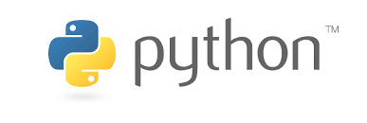


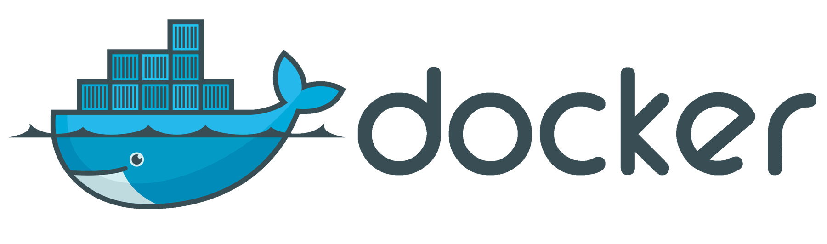
Types of packages
Microsoft platform and .NET artifacts
Node.js modules
Python scripts
Universal packages
Java packages
Docker images
NuGet Microsoft development platform and .NET artifacts
Npm node.js modules
Maven Java packages
Python Python script
Universal Set of related files
Docker Container images
Symbols Symbol files

Slide 53
Package feeds
Centralized storage of package artifacts
Public or privately available
Offer secure access for private feeds
Versioned storage of packages
Managed by tooling
Also known as
Package repositories
Package registry

Slide 54
Private and public feeds
Public
NuGet.org
Npmjs.org
PyPi.org
Docker Hub
Private feeds
MyGet
Azure Container Registry
Azure Artifacts
Self-hosted solution

Slide 55
Public sources
NuGet Gallery https://nuget.org
NPMjs https://npmjs.org
Maven https://search.maven.org
Docker Hub https://hub.docker.com
Python Package Index https://pypi.org

Slide 56
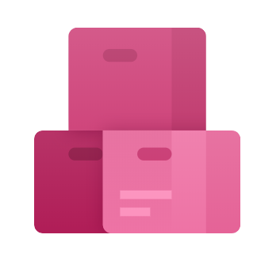
Azure Artifacts
Part of Azure DevOps
Create private and public package feeds
Types of packages supported
NuGet
NPM
Maven
Universal
Python

Slide 57
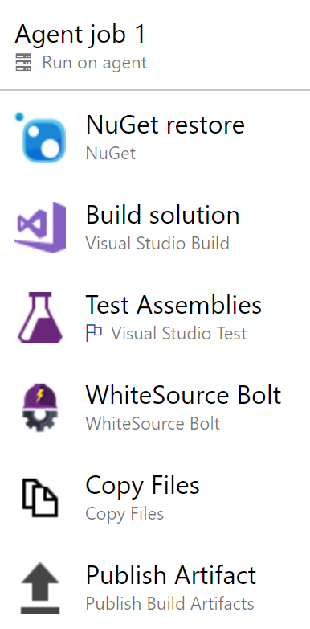

Integrating in build pipelines
Why integrate in build pipeline?
Automate to avoid errors
Quality checks
Implement a versioning strategy

Slide 58
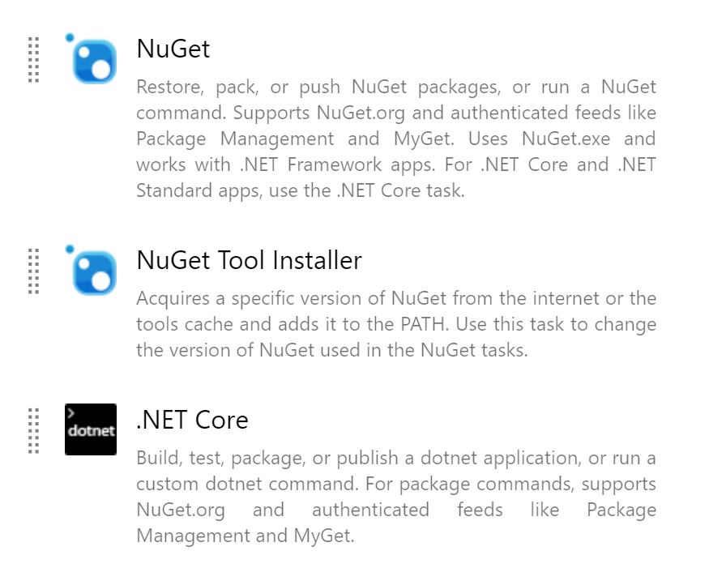
Azure Pipelines tasks
Different tasks for each of the package types
Native integration with Azure Artifacts feeds
Connecting with remote packages sources possible
Requires authentication

Slide 59
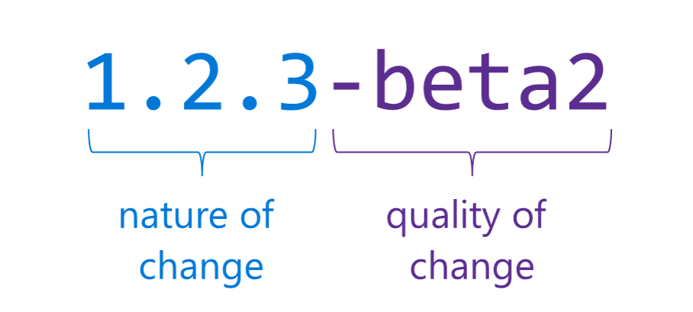
Semantic versioning
Express nature and risk of change
See also: https://semver.org

Slide 60
Practices to Measure End-User Satisfaction

Slide 61
Design Practices to Measure End-User Satisfaction
Outline your goals and plan.
Create a customer satisfaction survey.
Choose your survey’s trigger and timing.
Analyze the survey data.
Make adjustments and repeat.

Slide 62
Tools to Track System Usage, Feature Usage, and Flow

Slide 63
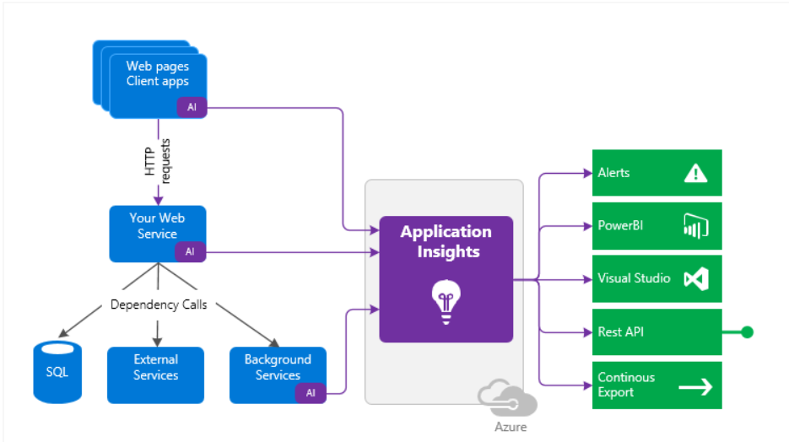

Slide 64
App Center Diagnostics
App Center Diagnostics is a cloud service that helps developers monitor the health of an application, delivering the data needed to understand what happens when an app fails during testing or in the wild.
In the App Center Diagnostics UI, you can attach, view and download one binary and one test attachment to your crash reports.
Track events leading up to a crash to capture useful information about the state of your app.

Slide 65
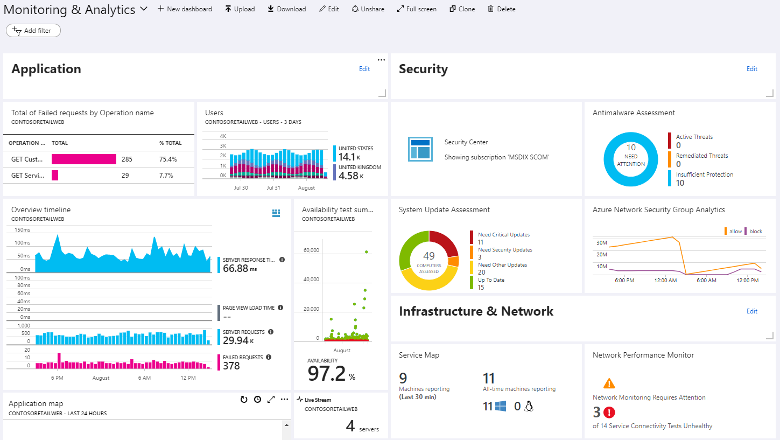
Azure Dashboards

Slide 66
Exam AZ-400 Exam Strategy

Slide 67
Tim's Certification Study Pyramid
Interdependence
Content knowledge
Practical application
Test-taking skills

Slide 68
Preparing for Online Testing

Slide 69

Why Microsoft Online Testing?
COVID means Pearson VUE physical testing centers are unavailable
The Pearson OnVUE client has come a LONG way
I'll use online testing exclusively from now on

Slide 70

Pearson OnVUE System Requirements
Windows 10 / Windows 8.1
macOS High Sierra (10.13)
4 GB RAM
1024x768/16 resolution
1920x1080/32 recommended
Touchscreens are prohibited

Slide 71

Pearson OnVUE System Requirements
3 Mbps down/up network bandwidth
Mobile hotspot tethering is prohibited
Browsers:
IE 11, Edge, Chrome, Firefox, or Safari (latest versions)

Slide 72

Pearson OnVUE System Requirements
Webcam: 640x480/10 fps
Microphone: integrated
Headsets not allowed
Corporate VPNs, firewalls, and proxies will likely disrupt the delivery
Check with networking team first

Slide 73
Your Pre-Exam Checklist
Computer set up
Kill all tasks except for your browser
May need to use Task Manager or Activity Monitor
Additional monitors turned off
Mobile phone
ID

Slide 74
During the Exam
Keep your face in the webcam frame
Keep your hands away from your mouth
Ensure you aren't interrupted
Walled room
Door closed
No bio breaks are allowed

Slide 75
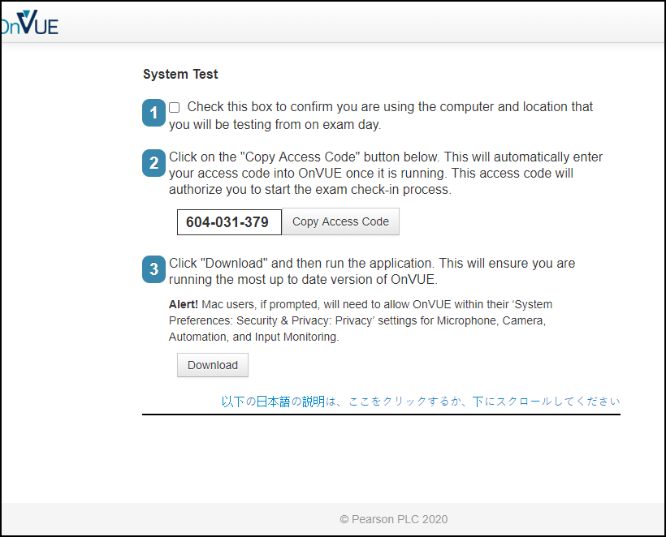

Slide 76
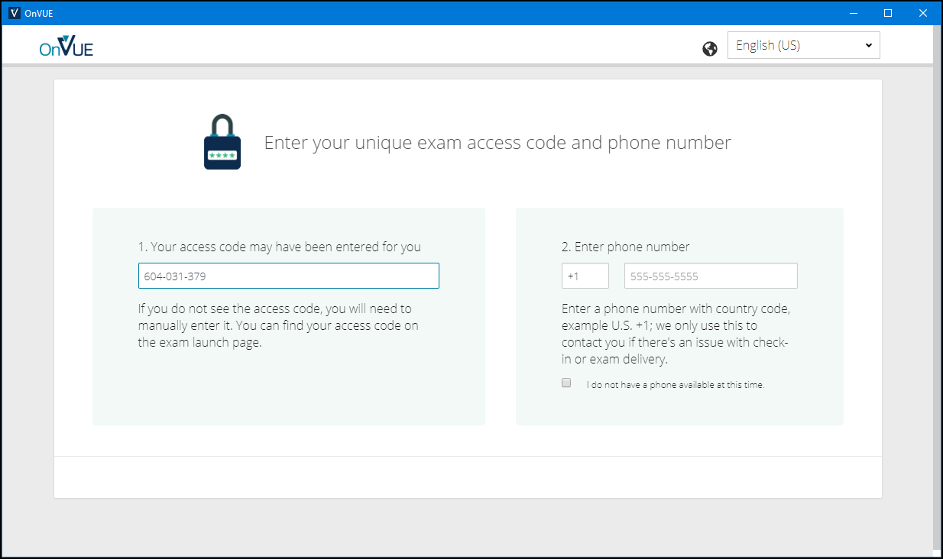

Slide 77
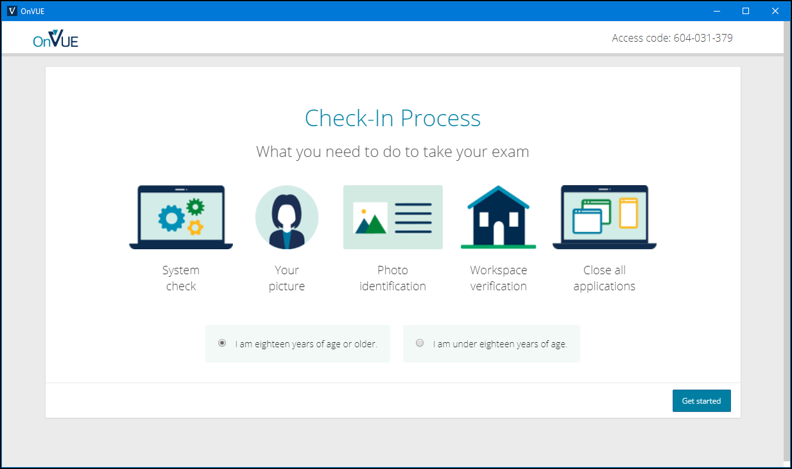

Slide 78
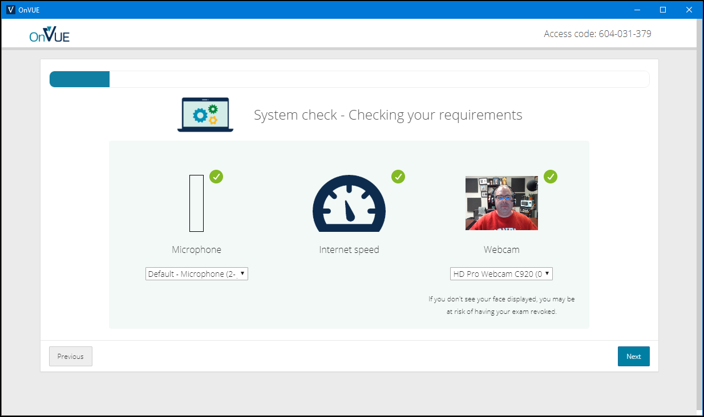

Slide 79
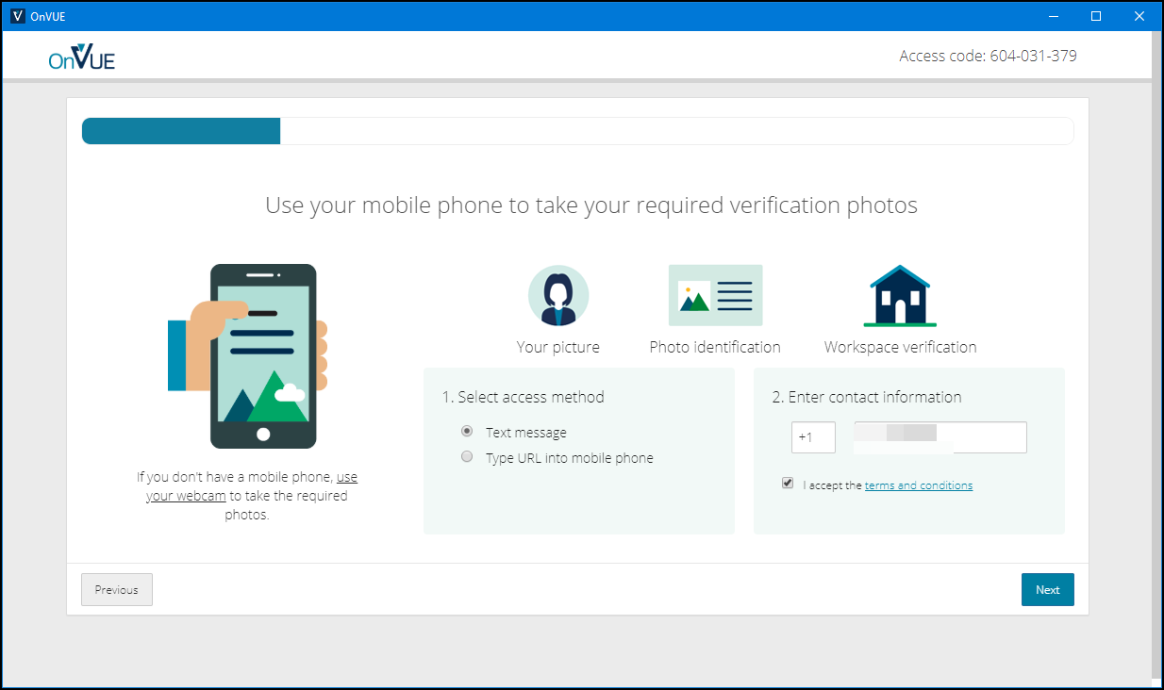

Slide 80
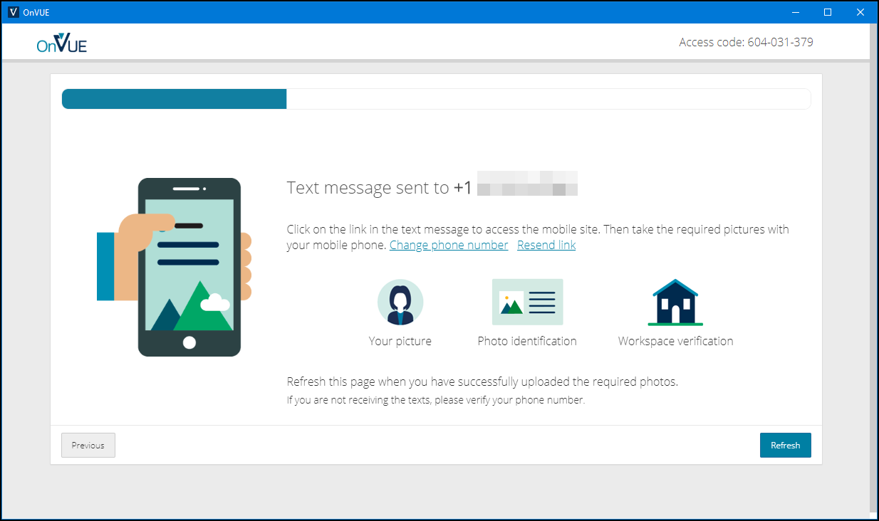

Slide 81
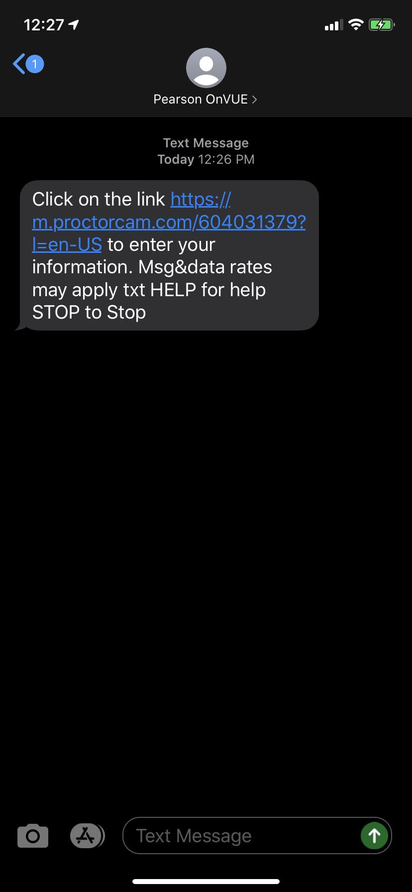
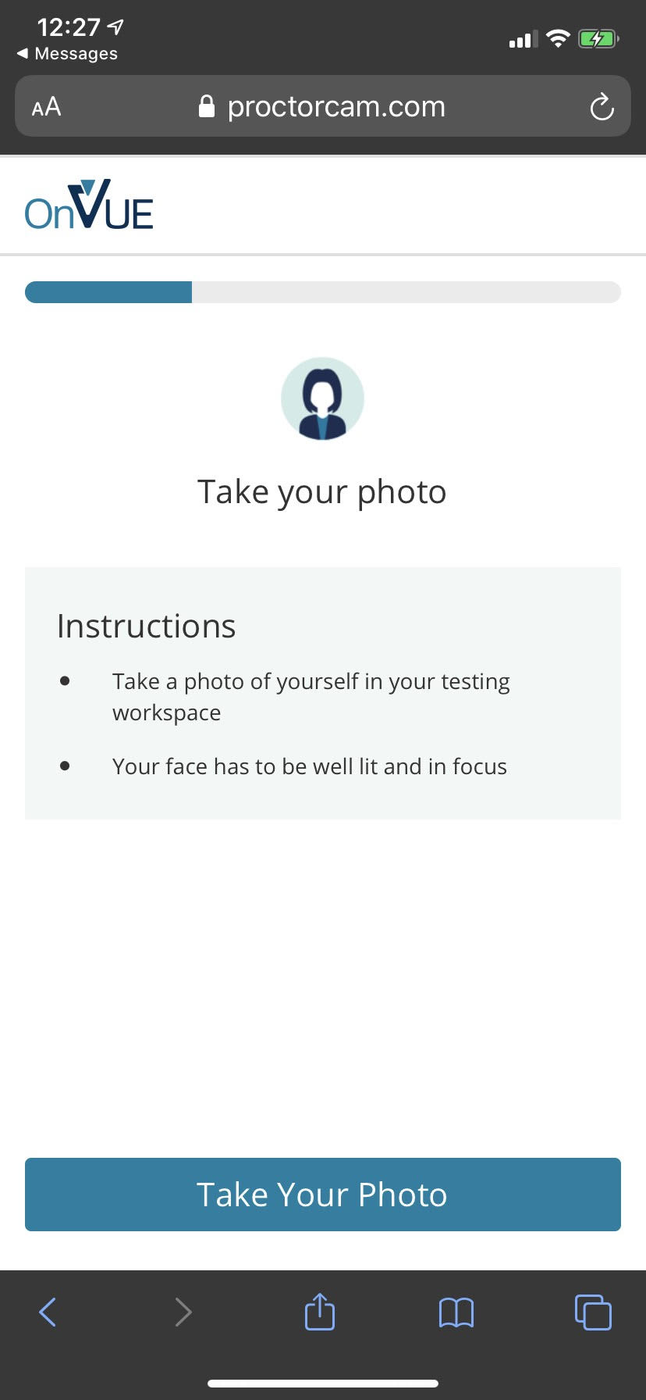
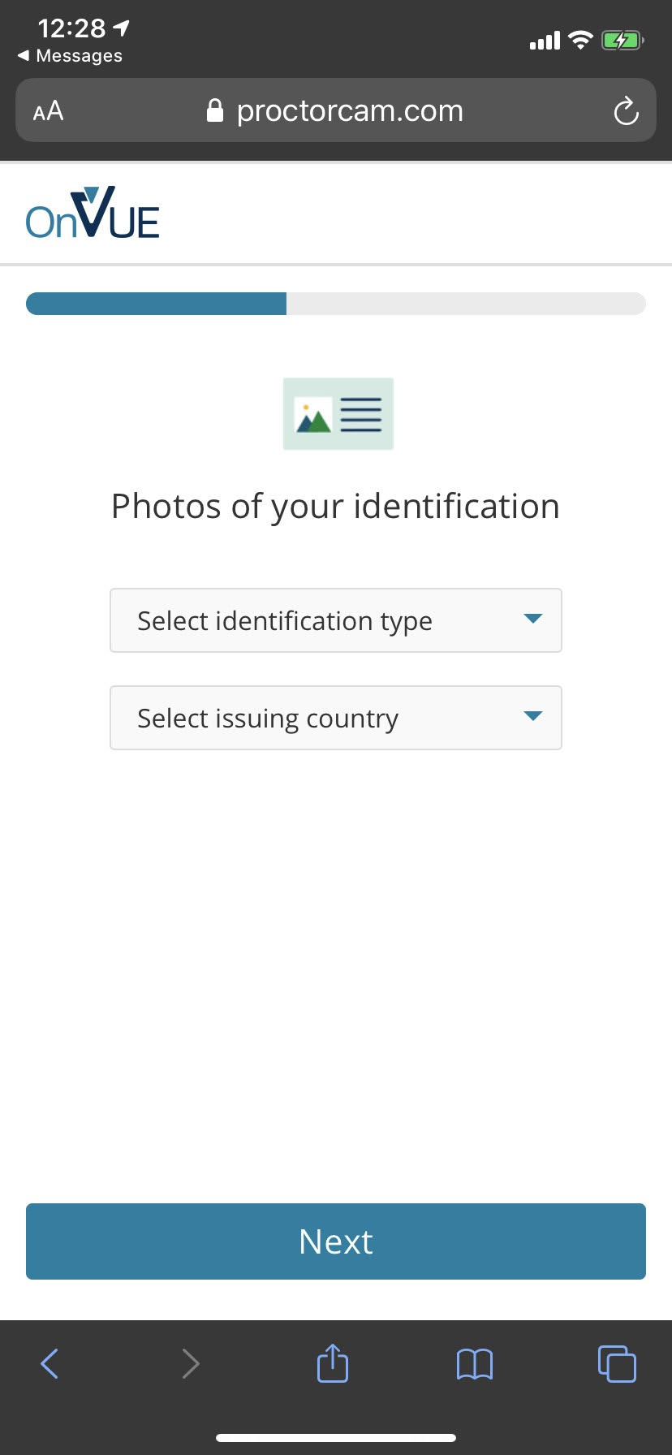

Slide 82
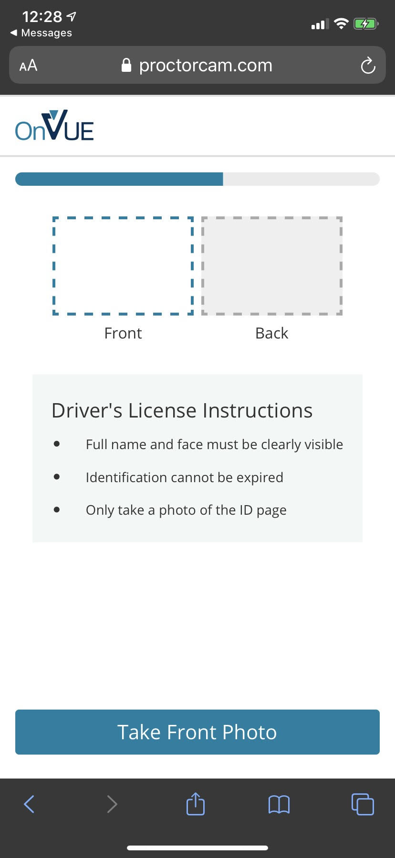
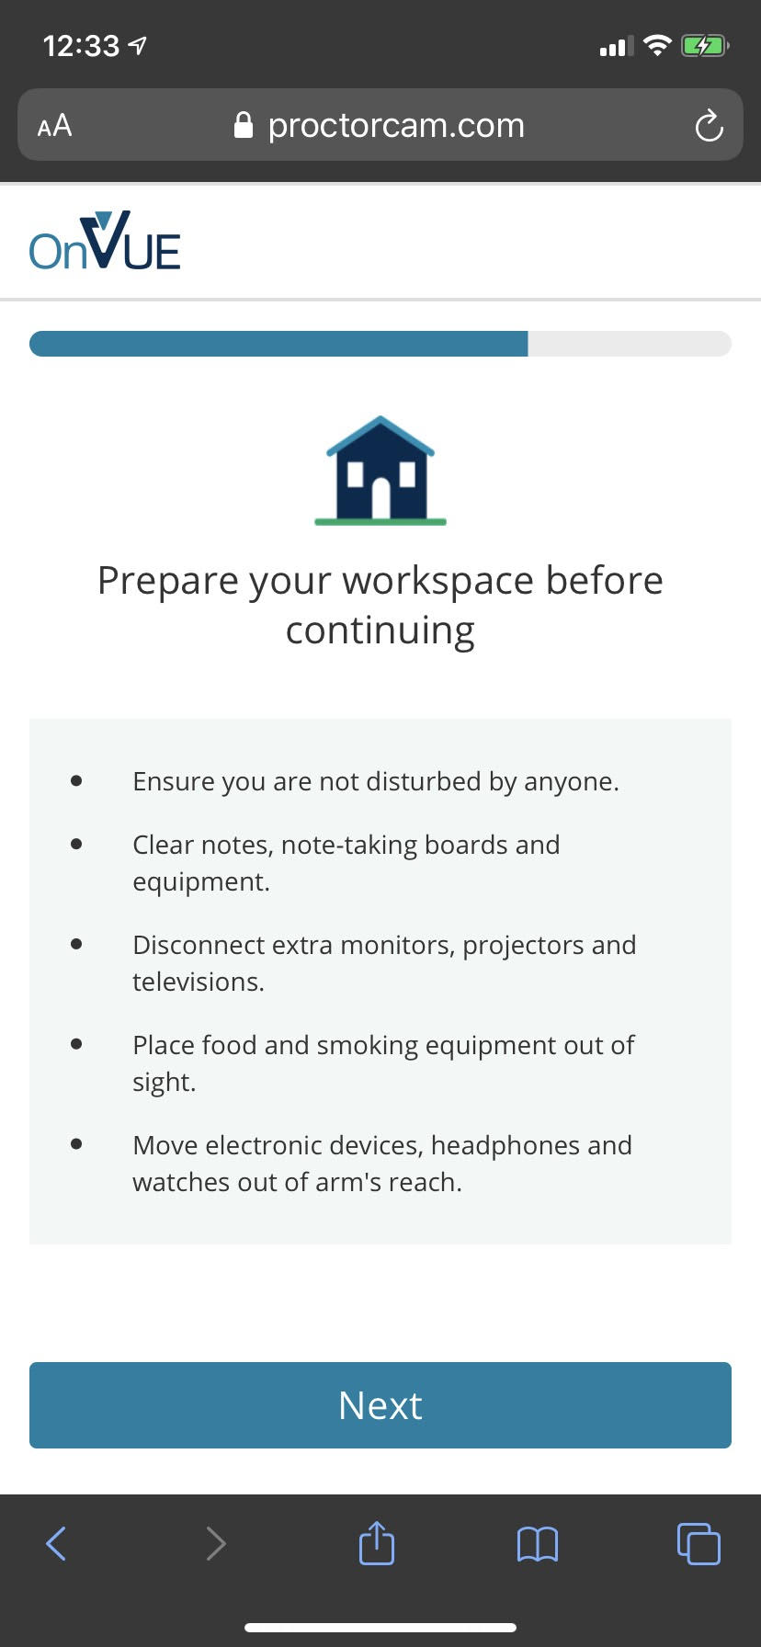

Slide 83
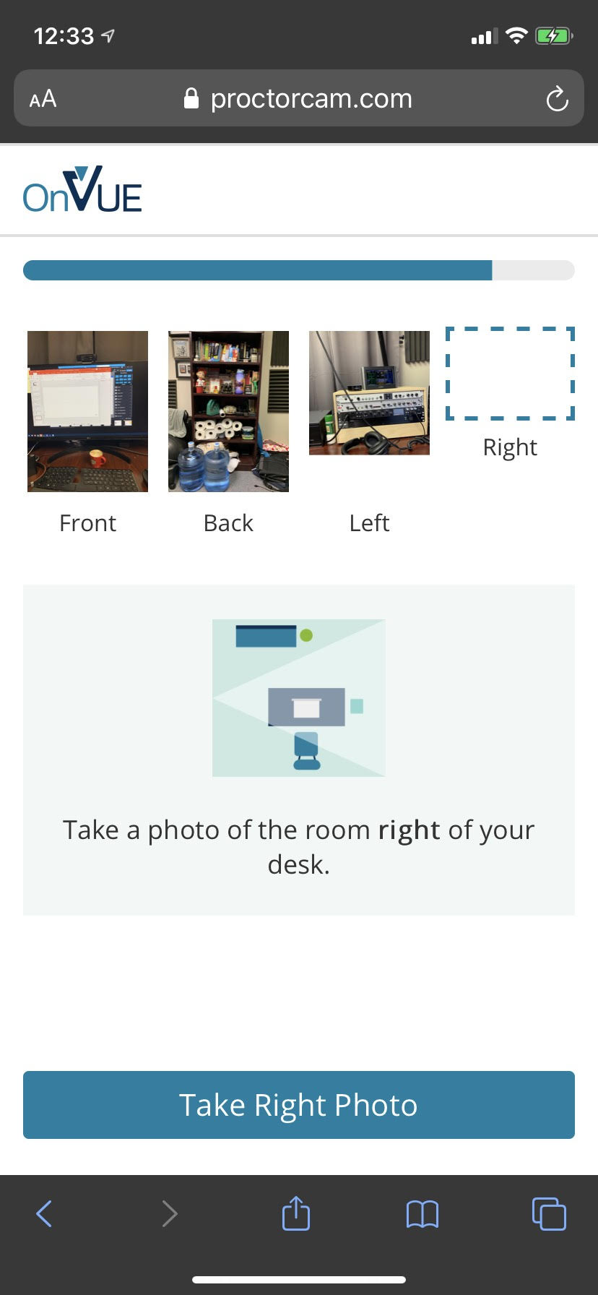
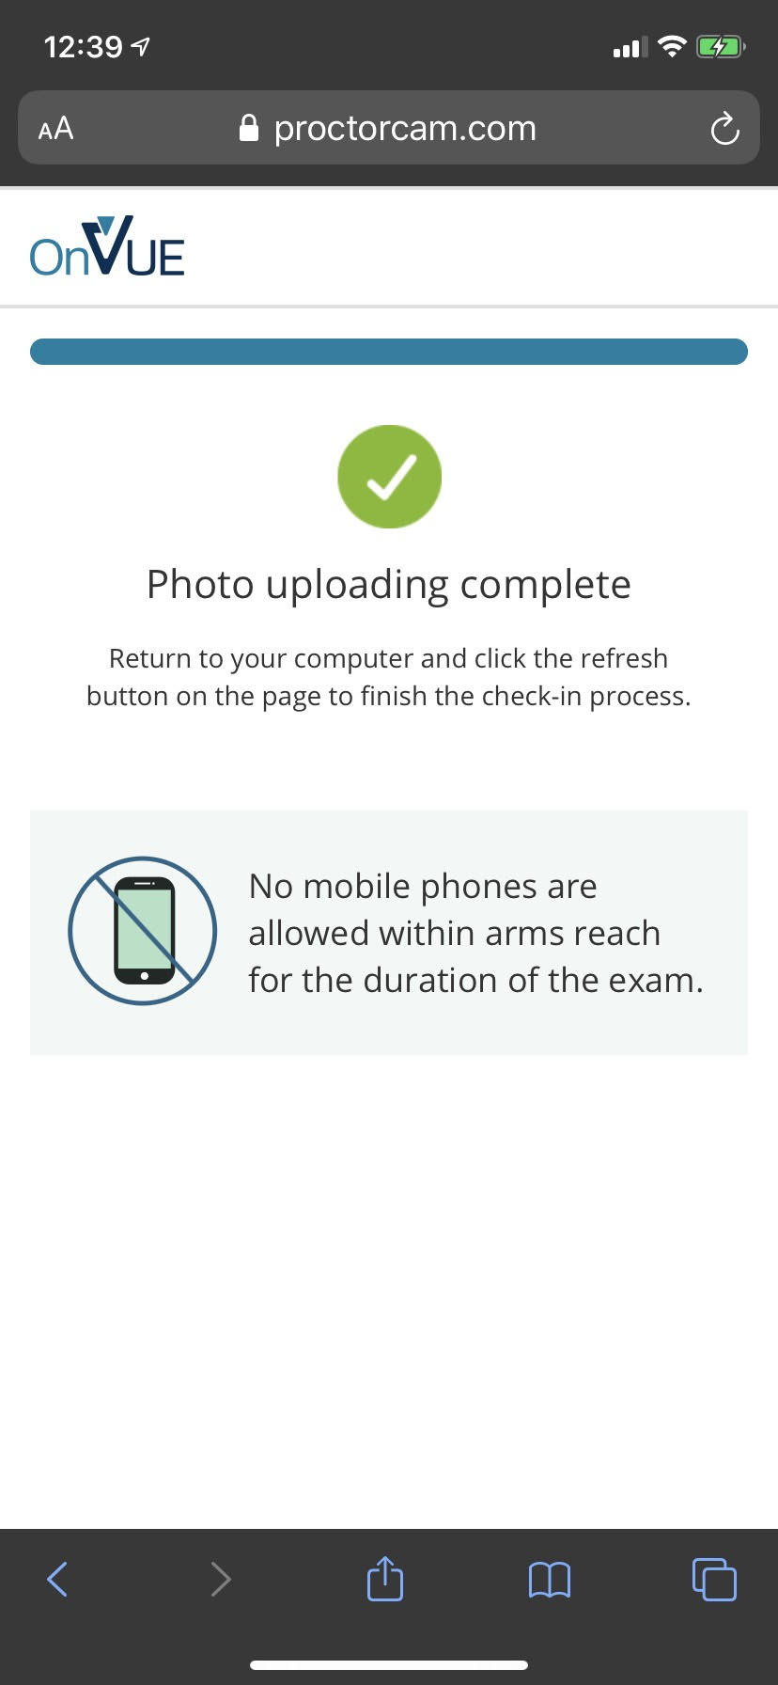

Slide 84
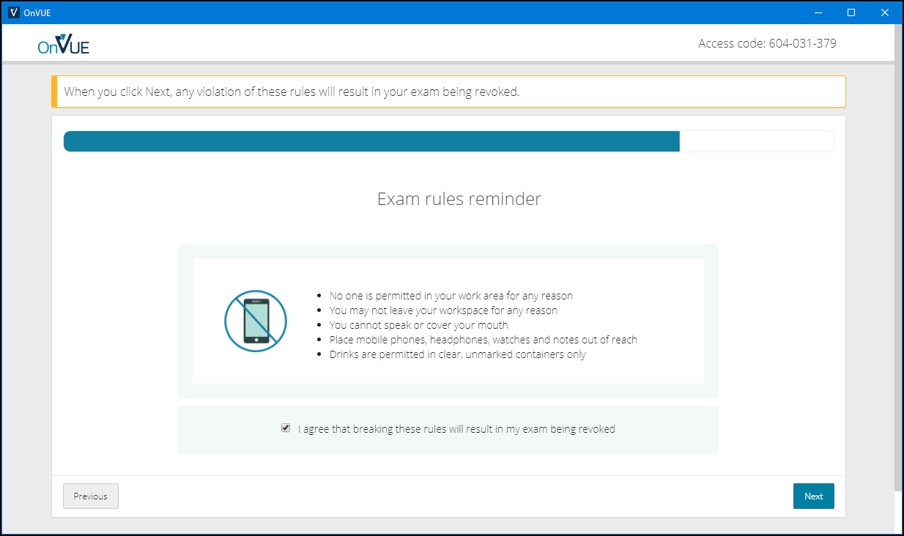

Slide 85
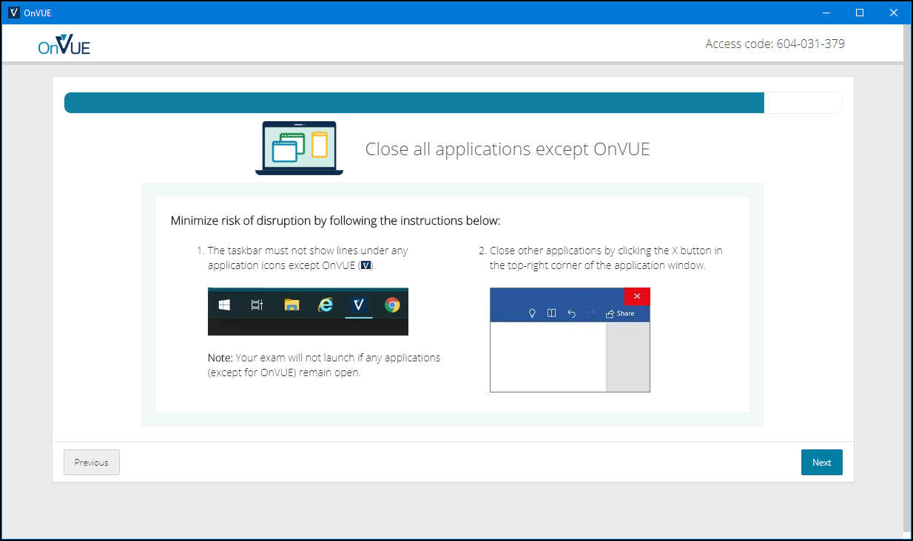

Slide 86
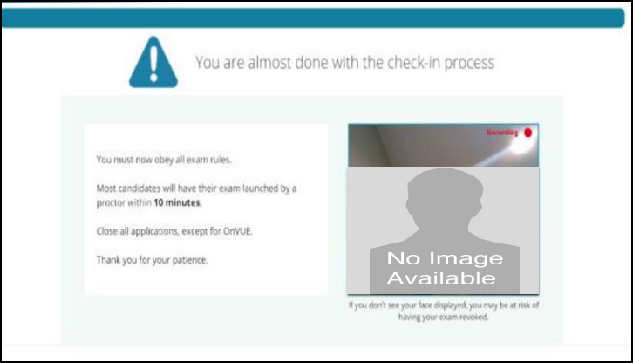

Slide 87
AZ-400 Exam Tips
Expect to see a lot of JSON, PowerShell, and Azure CLI
Expect NOT to see C# or JavaScript
It doesn't matter which exam order you use:
AZ-203
AZ-103/AZ-104
AZ-400
Perform due diligence in validating your environment for Microsoft online testing

Slide 88
Thank you!
Course materials: timw.info/az400
Twitter: @TechTrainerTim
Work: timw.info/ps
Web: TechTrainerTim.com

